Slide 1
VSLAM Co-operating UAVs
Thesis Members: Cornejo, Juan Raphael M.
Mapili, Lorenzo Mari A.
Pesit, Rigel
Young, Emmett
Thesis Adviser: Engr. Elmer R. Magsino

Slide 2
Presentation Overview:
Introduction
Statement of the Problem
Objectives
Scope and Delimitations
Hardware Interfaces for UAVs
Minor Developments
Major Developments
Data and Results
Concluding Remarks

Slide 3
Introduction

Slide 4
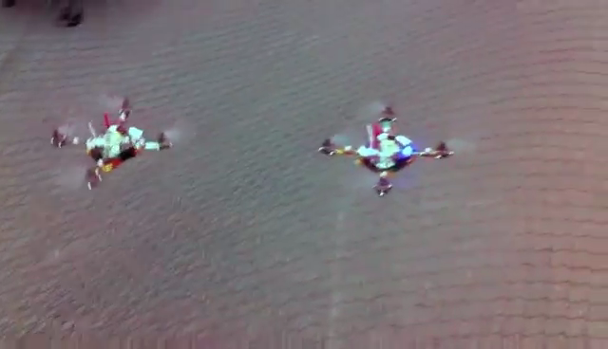
Introduction
GRASP Lab, University of Pennsylvania, https://www.youtube.com/watch?v=YQIMGV5vtd4
Alex Kushleyev, Daniel Mellinger, Vijay Kumar. Towards A Swarm of Agile Micro Quadrotors. Robotics: Science and system, July 2012
Notes:
There have been several significant researches that have emerged which had accelerated the technological advancements in fulfilling the dream of autonomous robots. Among these researches is the (swarm of nano quadrotors) that altogether creates a formation for themselves for execution in succession autonomously. The localization did not come from its on-board sensors. Several Vicon motion capture sensors located above the test area were used in order to gain the localization of the robots and with them, calculate the necessary motions for each quadrotors.

Slide 5
SLAM
Off-board sensors are impractical for autonomous operation.
With only on-board sensors, localization for robots are self-based.
The robot does not have any prior information about where it is.
The PARADOX: a robot cannot localize without having a map and it cannot create a map without knowing its location. This problem is well as known as SLAM.
The localization and mapping generated is only relative to the original position of the robot.
In this study, co-operating autonomous operation between robots is concerned.
Notes:
However, it is rather impractical to install off-board sensors for the localization of robots for autonomous operation. Thus, researches on utilizing on-board sensors for autonomous operation were conducted. With only on-board sensors, localization for robots are self-based. The robot does not have any prior information about where it is. However, a robot cannot localize without having a map and it cannot create a map without knowing its location. This problem is well known as SLAM.
It is also implied that upon utilizing SLAM in a robot, the localization and mapping generated is only relative to the original position of the robot. In this study, co-operating autonomous operation between robots is concerned.

Slide 6
Multi-SLAM
For on-board sensor-reliant robots, each robot does not know its relation to the other.
Applying a fixed initial distance between multiple robots for map merging is not sufficient.
As the SLAM continues, all of the corrections of the accumulated errors are only relative to the particular robot and not to the other robot’s relative position.
Disagreement in the generated map and location of each robots.
Multi-SLAM must be implemented to solve the challenge.
Notes:
Thus, autonomous operation of multiple on-board sensor reliant robots poses another challenge since each of the robot does not know its relation to the other. Knowing and applying a fixed initial distance between multiple robots in the hopes for overlaying each local map generated is deemed not sufficient. As the SLAM continues, all of the corrections of the accumulated errors are only relative to the particular robot and not to the other robot’s relative position. There would most likely result to disagreement in the generated map and as well as the location of each robots when the maps were overlay with the aforementioned initial distance. In hopes in solving this challenge, multi-SLAM must be implemented.

Slide 7
Autonomous Operation
With localization and mapping, autonomous operations are possible such as surveillance, coverage and exploration.
The study focuses on autonomous exploration of uncharted territories.
Autonomous operation module must be able to communicate properly with quadrotors.
Commands received by the quadrotors must be used for navigating the robot to its desired position and orientation.
From the highest level of abstraction down to the low level embedded system must be clearly defined.
Communication between the different modules must be seamless to work.
Notes:
With localization and mapping, autonomous operations are possible such as surveillance, coverage and exploration. The study focuses on autonomous exploration of uncharted territories. Autonomous operation module must be able to communicate properly with quadrotors. The commands received by the quadrotors must be then used for navigating the robot to its desired position and orientation. It follows that from the highest levels of abstraction such as logic and reasoning down to the low level embedded system such as fabricating boards for sensor data acquisition and controlling of actuators, as well as the programs that come with it must be clearly defined.

Slide 8
Statement of the Problem
Recent developments in autonomous mapping have major limitations that greatly decreases their productivity. Certain mapping robots have successfully and individually mapped its surrounding environment at a rather slow pace and minimal area due to the restrictions of their system, such is its battery life. One recently existing autonomous mapping system which made use of a quadrotor used a Microsoft Kinect camera and other sensors to achieve its goals. This system has successfully mapped multi-floored buildings quite effectively. However, due to the short battery life of a quadrotor (roughly 10-15 minutes), the system has a limited mapping area.
Another notable autonomous mapping system consists of multiple ground robots with cameras. This system successfully generates a 2D map after each machine is assigned an area on a master computer. Certain locations may not be reachable for the co-operating robots due to their limitations as ground vehicles.

Slide 9
Statement of the Problem
When dealing with visual simultaneous localization and mapping (VSLAM), difficulties in individual mapping would lie in pose and location estimation of each of the robots since any inaccuracy in a mapping iteration, due to limited sensor precision and noise, would magnify and carry on to the next. These difficulties, however, should be addressed by implementing a VSLAM algorithm which would then be extended to support co-operation. However a new problem arises when fusing the information from different multiple quadrotor platforms to produce one coherent map.

Slide 10
General Objective:
To implement localization, mapping, planning and control of an autonomous quadrotor using visual simultaneous localization and mapping (VSLAM) extended to support co-operation.

Slide 11
Specific Objectives:
To assemble two (2) quadrotors, each mounted with a RGB-D camera as the primary sensor of the system, a processor, flight controller, and an IMU sensor with the same operations to generate a single coherent map.
To successfully achieve communication between the PC and on-board processor wirelessly.

Slide 12
Specific Objectives:
To implement a 2D vSLAM algorithm to produce the global map of the environment and the robot’s location in the map.
To program a GUI that presents the 2D map of a single floor without prior information of the area to be mapped by the cooperating quadrotors.

Slide 13
Specific Objectives:
To test the whole process ten (10) times in three (3) indoor environments in both single and co-operative modes which amounts to a total of sixty (60) trials overall.
To quantify the improvement of the co-operative mode over the single mode based on the scanning time measurement across all trials.

Slide 14
Scope and Delimitation
Only two (2) quadrotors are to be employed.
Controlled working environment (e.g. static, lighted and indoor environment)
Exploration is limited within Wi-Fi signal range and on a single floor.
Autonomous operation greatly depends on the localization.
Since the study focuses on the application use of quadrotors, the design of an original flight control system is not of concern in this study.

Slide 15
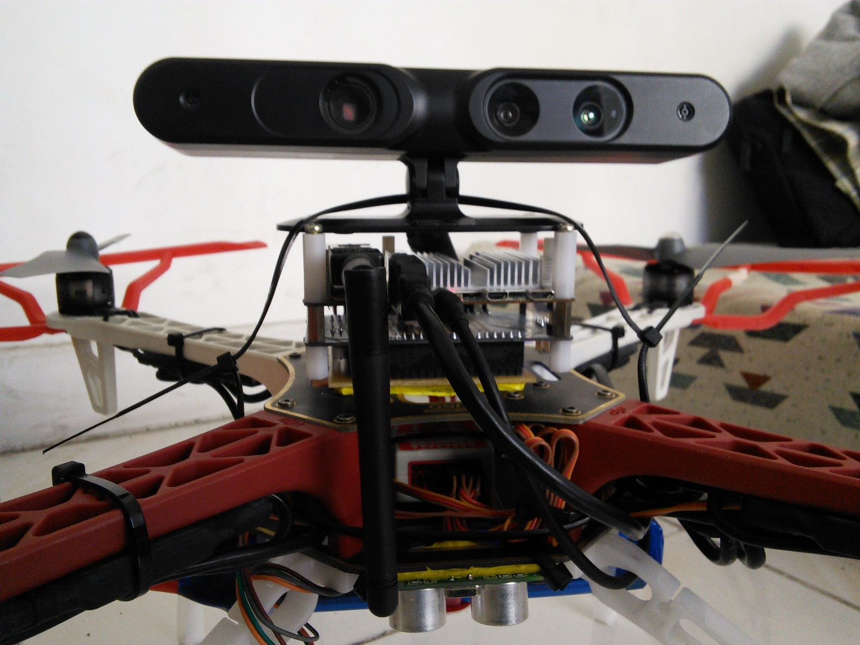
Hardware interfaces for uavs
Odroid U3
Odroid U3 I/O Shield
WiFi dongle
Xtion Pro Live
Ultrasonic Sensor
Lipo Battery

Slide 16
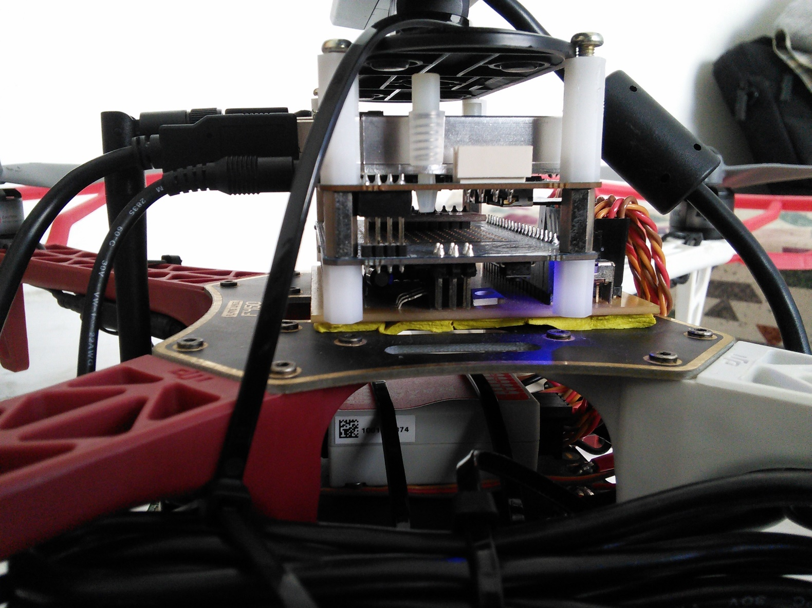
Hardware interfaces for uavs
IMU
Flight Controller

Slide 17
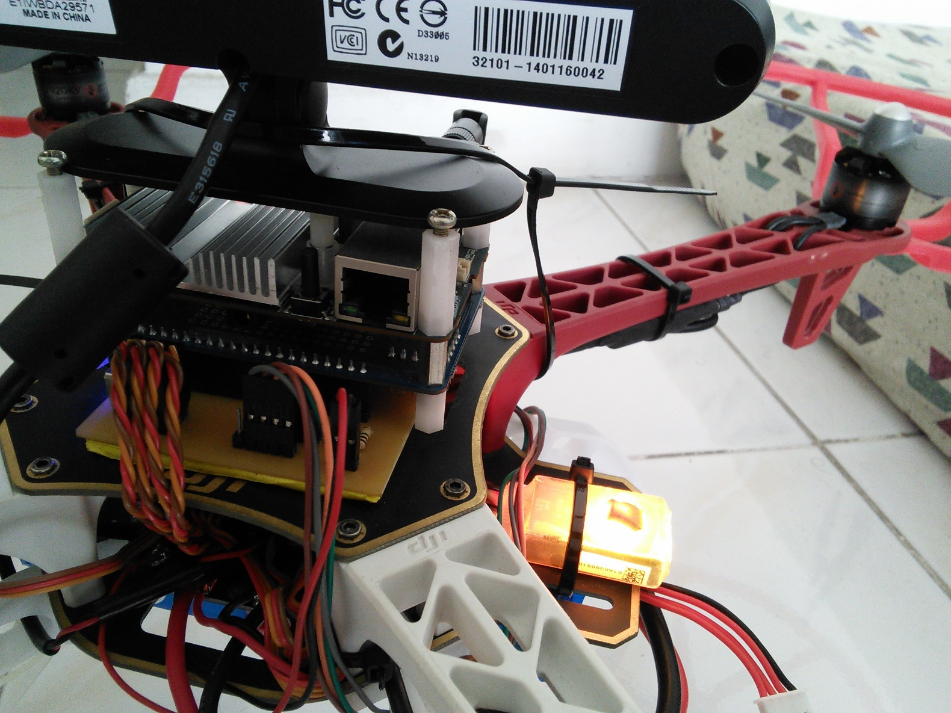
Hardware interfaces for uavs
I/O Shield Breakout board
Battery Monitoring System
Versatile Unit
ESCs
Motor

Slide 18
Minor Developments
Notes:
Minor Developments
Communication Module (odroid listener & odroid serial)
Telemetry
Control tests
Communication Module
Notes:
Communication plays a vital role in the process of the system. With the use of TCPROS (a transport layer for ROS messages and services) exchange of messages between the different components of the system is done with ease. The on-board processor of the quadrotor as discussed in the hardware interfaces is equipped with a wireless adapter which is used to establish communication with the base station computer. Through TCPROS and a WIFI connection the on-board processor can transmit and receive data to and from the base station computer. We created a communication module (odroidlistener) in the on-board processor to handle all the incoming and outgoing wireless data. Data coming from the base station computer are commands that are used to control the flight operation of the quadrotor while data coming from the on-board processor are telemetry data which are used to monitor the status of the quadrotor. The communication module passes command data to the different controller modules we have created to control the flight movements of the quadrotor. Another communication module that was created (odroidserial) is in charge of transmitting and receiving data from the arduino (IO Shield) through serial communication. Data from the sensors pass as well as data to the flight controllers pass through this module.
The Telemetry module is created in order to monitor the quadrotors' actual and goal height and yaw as well as the battery levels. Included in the telemetry module are the command controls which are used to give manual commands such as start/unstart, arm/disarm, land, and set goal height/yaw to the quadrotor's on-board processor.

Slide 19
Major Developments

Slide 20
Quadrotor control
The Conventional Way
A Flight Controller receives commands of PWM signals from the receiver.
These signals correspond to the stick positions of a radio transmitter.
The signal consists of a servo command, a 1ms to 2ms pulse in a 20ms period.
These commands are sent to four (4) channels, namely:
Aileron – controls the roll
Elevator – controls the pitch
Throttle – controls the throttle
Rudder – controls the yaw

Slide 21
Quadrotor control
Implemented quadrotor control
The Flight Controller receives commands of PWM signals from the I/O Shield.
The I/O Shield receives a value from 1000 to 2000 from the Odroid U3 which is translated to microseconds.
The signal consists of a servo command, a 1ms to 2ms pulse in a 20ms period.
These commands are sent to four (4) channels, namely:
Aileron – controls the roll
Elevator – controls the pitch
Throttle – controls the throttle
Rudder – controls the yaw

Slide 22
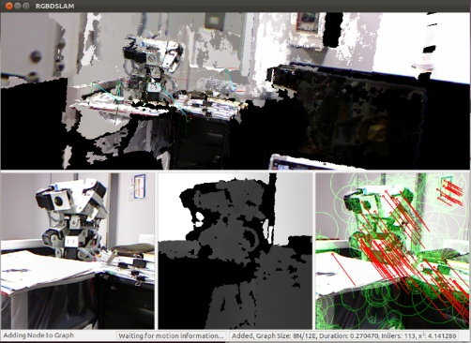
MULTI RGBDSLAM
a modified version of the RGBDSLAM, an open-source graph-based SLAM system that uses an RGB-D camera to create a colored 3D representation of the environment

Slide 23
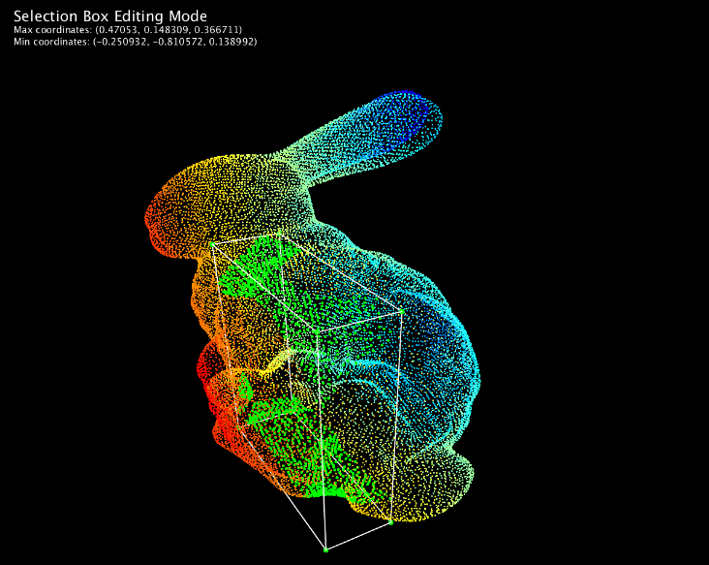
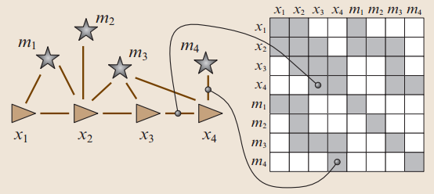
MULTI RGBDSLAM
uses the General (Hyper) Graph Optimization (g2o) library to store and optimize the graph of SLAM system
uses the Point Cloud Library (PCL) to visualize the RGB and depth images in 3D

Slide 24
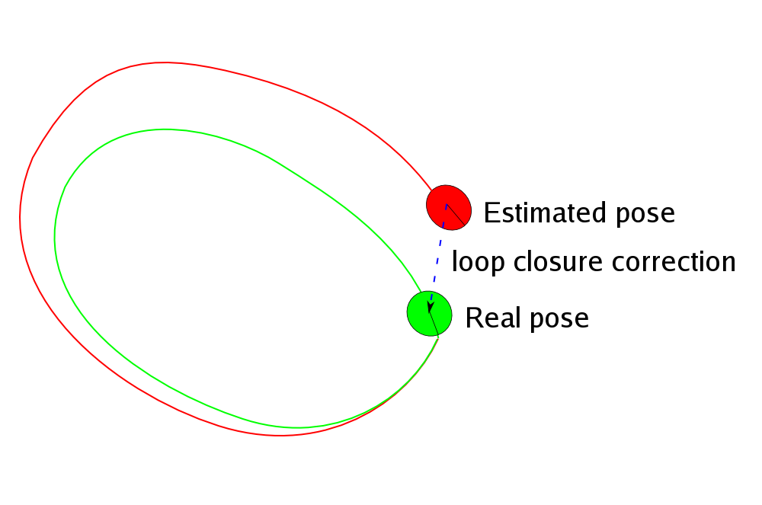
MULTI RGBDSLAM
performs loop closure, a technique performed when previous landmarks are recorded again after a period of time; the estimated trajectory from the span of time is adjusted to make the same landmark be placed on the same coordinates

Slide 25
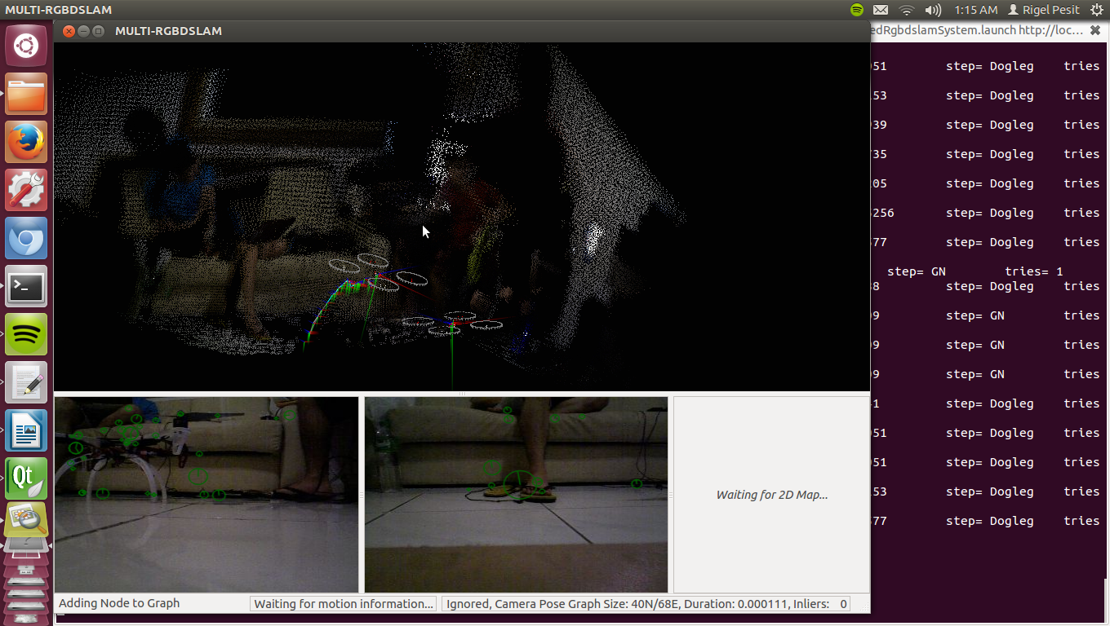
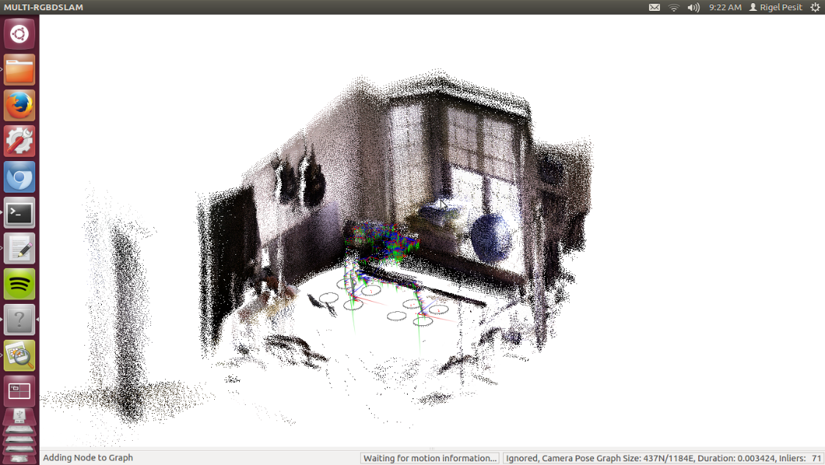
MULTI RGBDSLAM
modifications were made such that the system can make use of user adjustable number of cameras instead of just one while still being able to maintain the system’s ability to loop close.

Slide 26
Navigation Stack
Notes:
For the autonomous operation, we present here the navigation stack from one of the lectures of Dr. Sturm entitled Autonomous Navigation for Flying Robots.
It shows the hierarchy of relationships between different modules that ultimately provides autonomous operation to mobile robots once integrated. As evidently seen, autonomous operation is extremely difficult as the higher layers of operation greatly depends on its lower layers; one unstable module may cause failure to the autonomous operation. The low-level embedded systems which reads the sensor readings and controls the actuator which enables the robot to interact with the physical world can be used as the foundation of higher level robotic applications such as position control. The position control takes in its goal position and uses sensors to provide pose estimation of the robot to provide motor commands to the robot until it successful reach the goal and holds its position.
The foundation discussed above is to be utilized in the autonomous operation and the planning can be split into four parts namely, task planner, mission planner, global planner and local planner. We do not need the task planner as it again only adds another layer which serves as a friendly user interface to non-geeky people which can then be used for commercial purposes.
We only adapted the mission planner, global planner, global map generation by SLAM, local planner and localization. Since dynamic environments is not of concern in this study, the part of local planner and position control were combined and simplified.
The goal of the mission planner as defined by Dr. Sturm is to generate and execute a plan to accomplish a certain (navigation) task which varies from exploration, coverage, surveillance and tracking. For this study, the task chosen was exploration of uncharted territory. The exploration algorithm is to be implemented in the mission planner which eventually must be interfaced to the global planner. Especially as in the case of cooperation, the mission planner must take into account the current position of both robots in the map to intelligently make target assignments for each robot that seeks to minimize the overall cost and maximize the information gain as fast as possible.
The global planner is also known as the path planner. Given destination goal point from the mission planner, it takes the occupancy grid map and the current position of the robot and compute a collision-free path starting from the pose of the robot towards the goal. However, the robot is not point in size. The radius of the robot must be taken into account when constructing the path. Dr. Sturm argued that inflating the map is the solution. The inflation of the map was performed by the use of distance map and were used for both the mission and global planner.
The role of the local planner would only be just to move from point A to point B, keeping at its best to follow the path.

Slide 27
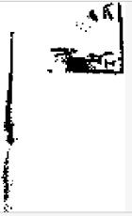

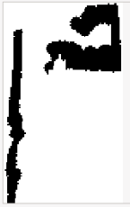


Inflation of Map
Binary Map
Distance Map
Inflated Binary Map
Ternary Map
Inflated
Ternary Map
Notes:
For the inflation of the map,

Slide 28
Navigation Stack
Notes:
For the autonomous operation, we present here the navigation stack from one of the lectures of Dr. Sturm entitled Autonomous Navigation for Flying Robots.
It shows the hierarchy of relationships between different modules that ultimately provides autonomous operation to mobile robots once integrated. As evidently seen, autonomous operation is extremely difficult as the higher layers of operation greatly depends on its lower layers; one unstable module may cause failure to the autonomous operation. The low-level embedded systems which reads the sensor readings and controls the actuator which enables the robot to interact with the physical world can be used as the foundation of higher level robotic applications such as position control. The position control takes in its goal position and uses sensors to provide pose estimation of the robot to provide motor commands to the robot until it successful reach the goal and holds its position.
The foundation discussed above is to be utilized in the autonomous operation and the planning can be split into four parts namely, task planner, mission planner, global planner and local planner. We do not need the task planner as it again only adds another layer which serves as a friendly user interface to non-geeky people which can then be used for commercial purposes.
We only adapted the mission planner, global planner, global map generation by SLAM, local planner and localization. Since dynamic environments is not of concern in this study, the part of local planner and position control were combined and simplified.
The goal of the mission planner as defined by Dr. Sturm is to generate and execute a plan to accomplish a certain (navigation) task which varies from exploration, coverage, surveillance and tracking. For this study, the task chosen was exploration of uncharted territory. The exploration algorithm is to be implemented in the mission planner which eventually must be interfaced to the global planner. Especially as in the case of cooperation, the mission planner must take into account the current position of both robots in the map to intelligently make target assignments for each robot that seeks to minimize the overall cost and maximize the information gain as fast as possible.
The global planner is also known as the path planner. Given destination goal point from the mission planner, it takes the occupancy grid map and the current position of the robot and compute a collision-free path starting from the pose of the robot towards the goal. However, the robot is not point in size. The radius of the robot must be taken into account when constructing the path. Dr. Sturm argued that inflating the map is the solution. The inflation of the map was performed by the use of distance map and were used for both the mission and global planner.
The role of the local planner would only be just to move from point A to point B, keeping at its best to follow the path.

Slide 29


Mission planner
Notes:
The mission planner is composed of primarily two steps namely frontier detection and target assignment for each robots. Frontier detection is used for identifying unexplored areas which are characterized by the boundary between free and unknown cells. We begin by retrieving the latest ternary map and binary map. Ternary map represents the original grid map which contains three values namely free, occupied and unknown cells. To get the binary map, we filtered the ternary map such that every unknown cells become free cells. We proceed in performing canny edge detection for both ternary and binary map. Our concern here is to only get the frontier edges which can be done by just subtracting the binary edge image from ternary edge image. We dilate the frontier edge image to remove false frontier edges which are basically noises. Our goal here is to identify the coordinates of the frontiers. For this reason, the OpenCV library offers a contour detection function that takes in the frontier edge image and returns the contours as a 2D array. We computed the center of gravities of each contours to summarize the contours into one point. However, since the global planner cannot make paths through unknown and occupied cells and there is the great possibility of the center of gravities fall unto the unknown area which happens, the frontier goals must be relocated. For this operation, Dijkstra’s algorithm was used to relocate the frontier goal to the nearest free cell.
Given a set of frontier goals and the current position of the robots, hungariam algorithm was used in computing the optimal target assignments for each robots. The cost matrix was derived from Dijkstra’s algorithm which also effectively filters unreachable targets from each robots.

Slide 30


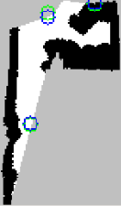
Mission planner
Notes:
The mission planner is composed of primarily two steps namely frontier detection and target assignment for each robots. Frontier detection is used for identifying unexplored areas which are characterized by the boundary between free and unknown cells. We begin by retrieving the latest ternary map and binary map. Ternary map represents the original grid map which contains three values namely free, occupied and unknown cells. To get the binary map, we filtered the ternary map such that every unknown cells become free cells. We proceed in performing canny edge detection for both ternary and binary map. Our concern here is to only get the frontier edges which can be done by just subtracting the binary edge image from ternary edge image. We dilate the frontier edge image to remove false frontier edges which are basically noises. Our goal here is to identify the coordinates of the frontiers. For this reason, the OpenCV library offers a contour detection function that takes in the frontier edge image and returns the contours as a 2D array. We computed the center of gravities of each contours to summarize the contours into one point. However, since the global planner cannot make paths through unknown and occupied cells and there is the great possibility of the center of gravities fall unto the unknown area which happens, the frontier goals must be relocated. For this operation, Dijkstra’s algorithm was used to relocate the frontier goal to the nearest free cell.
Given a set of frontier goals and the current position of the robots, hungariam algorithm was used in computing the optimal target assignments for each robots. The cost matrix was derived from Dijkstra’s algorithm which also effectively filters unreachable targets from each robots.

Slide 31
Mission planner
Given a set of candidate frontiers and two robot’s poses, Hungarian algorithm computes the optimal target assignments for each robot.
The cost matrix was derived from Dijkstra’s algorithm which effectively filters unreachable targets from each robots.

Slide 32
Navigation Stack
Notes:
For the autonomous operation, we present here the navigation stack from one of the lectures of Dr. Sturm entitled Autonomous Navigation for Flying Robots.
It shows the hierarchy of relationships between different modules that ultimately provides autonomous operation to mobile robots once integrated. As evidently seen, autonomous operation is extremely difficult as the higher layers of operation greatly depends on its lower layers; one unstable module may cause failure to the autonomous operation. The low-level embedded systems which reads the sensor readings and controls the actuator which enables the robot to interact with the physical world can be used as the foundation of higher level robotic applications such as position control. The position control takes in its goal position and uses sensors to provide pose estimation of the robot to provide motor commands to the robot until it successful reach the goal and holds its position.
The foundation discussed above is to be utilized in the autonomous operation and the planning can be split into four parts namely, task planner, mission planner, global planner and local planner. We do not need the task planner as it again only adds another layer which serves as a friendly user interface to non-geeky people which can then be used for commercial purposes.
We only adapted the mission planner, global planner, global map generation by SLAM, local planner and localization. Since dynamic environments is not of concern in this study, the part of local planner and position control were combined and simplified.
The goal of the mission planner as defined by Dr. Sturm is to generate and execute a plan to accomplish a certain (navigation) task which varies from exploration, coverage, surveillance and tracking. For this study, the task chosen was exploration of uncharted territory. The exploration algorithm is to be implemented in the mission planner which eventually must be interfaced to the global planner. Especially as in the case of cooperation, the mission planner must take into account the current position of both robots in the map to intelligently make target assignments for each robot that seeks to minimize the overall cost and maximize the information gain as fast as possible.
The global planner is also known as the path planner. Given destination goal point from the mission planner, it takes the occupancy grid map and the current position of the robot and compute a collision-free path starting from the pose of the robot towards the goal. However, the robot is not point in size. The radius of the robot must be taken into account when constructing the path. Dr. Sturm argued that inflating the map is the solution. The inflation of the map was performed by the use of distance map and were used for both the mission and global planner.
The role of the local planner would only be just to move from point A to point B, keeping at its best to follow the path.

Slide 33
Global and Local Planner
The global planner takes in the inflated map, current pose and goal in creating a collision-free path using Dijkstra’s algorithm.
The global planner only forwards valid path to the local planner.
The local planner receives an array of points that represent the path and converts them into yaw and pitch commands.

Slide 34
Data and Results

Slide 35
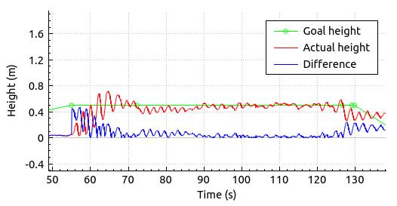
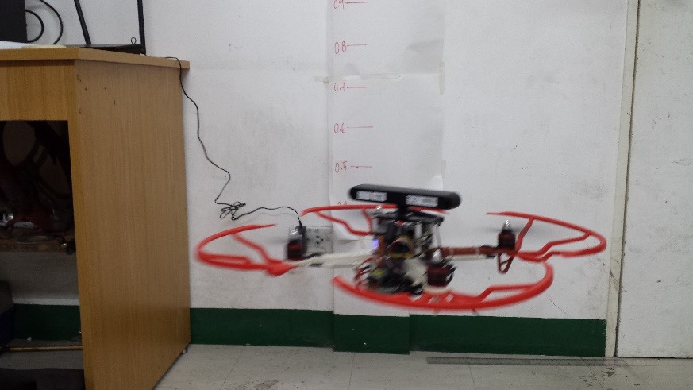
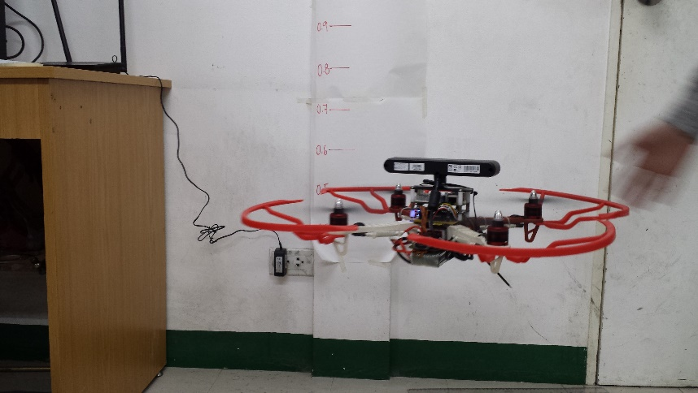
Quadrotor control

Slide 36
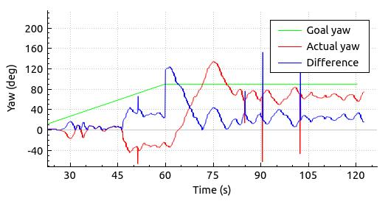
Quadrotor control

Slide 37
MULTI RGBDSLAM
In order to test the performance of the modified SLAM system and at the same time select the best feature detection/extraction to be used for further tests, three trials of mapping of each type of feature detector/extractor were made.

Slide 38
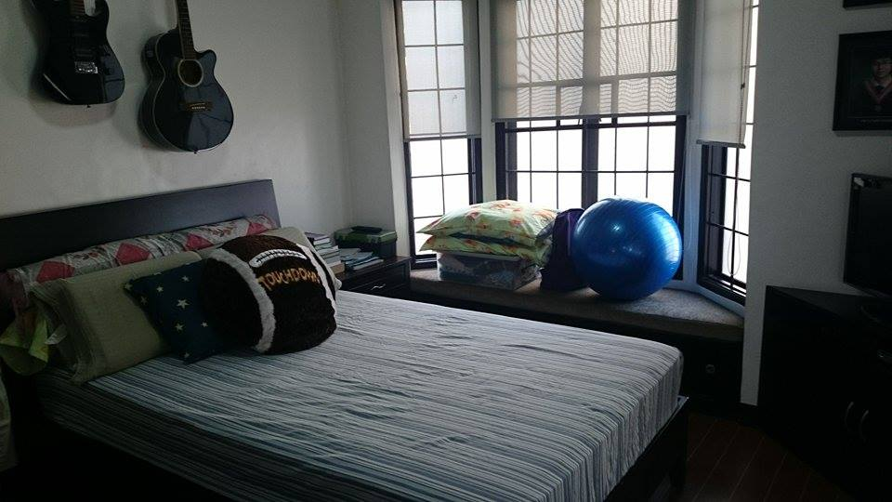
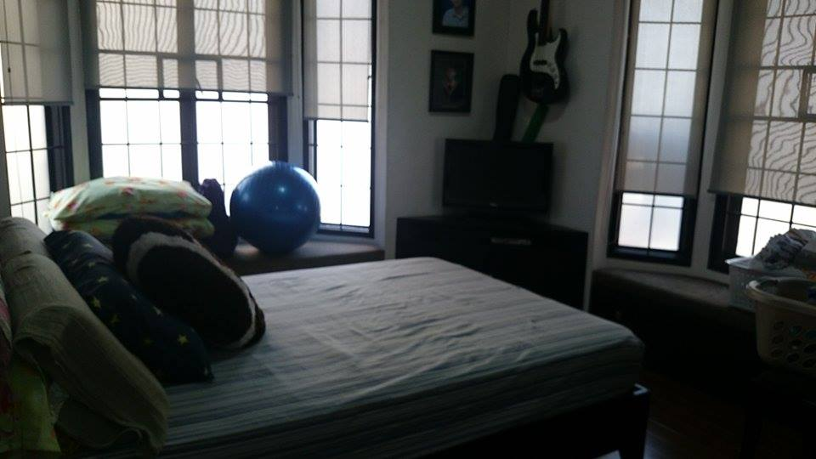
Emmett’s Room

Slide 39
MULTI RGBDSLAM (SURF)
Trial | Result w/ inter- camera Loop Closure | Result w/o inter-camera Loop Closure
1 | Success | Fail
2 | Success | Fail
3 | Success | Fail

Slide 40
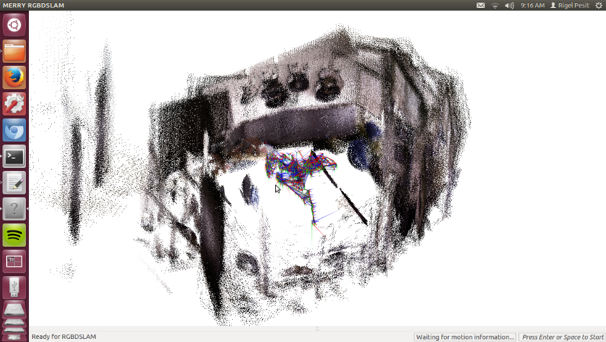
MULTI RGBDSLAM (SURF)

Slide 41
MULTI RGBDSLAM (SIFT)
Trial | Result w/ inter- camera Loop Closure | Result w/o inter-camera Loop Closure
1 | Half | Small Unmapped Area but Camera 1 stopped early
2 | Small Unmapped Area | Fail
3 | Half | Fail

Slide 42
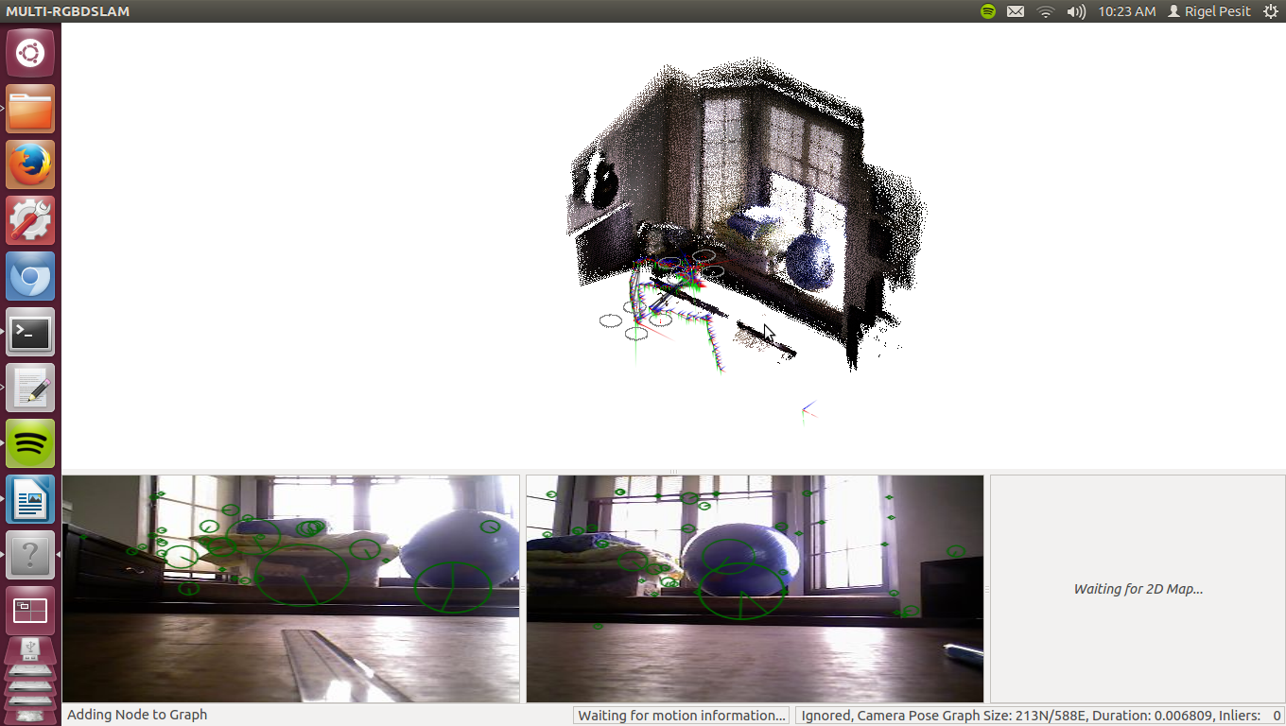
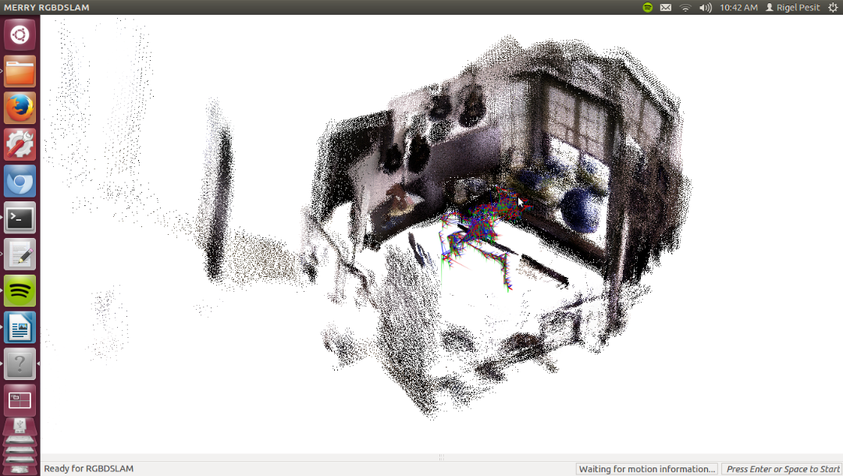
MULTI RGBDSLAM (SIFT)

Slide 43
MULTI RGBDSLAM (ORB)
Trial | Result w/ inter- camera Loop Closure | Result w/o inter-camera Loop Closure
1 | Success | Fail
2 | Small Unmapped Area | Fail
3 | Success | Fail

Slide 44
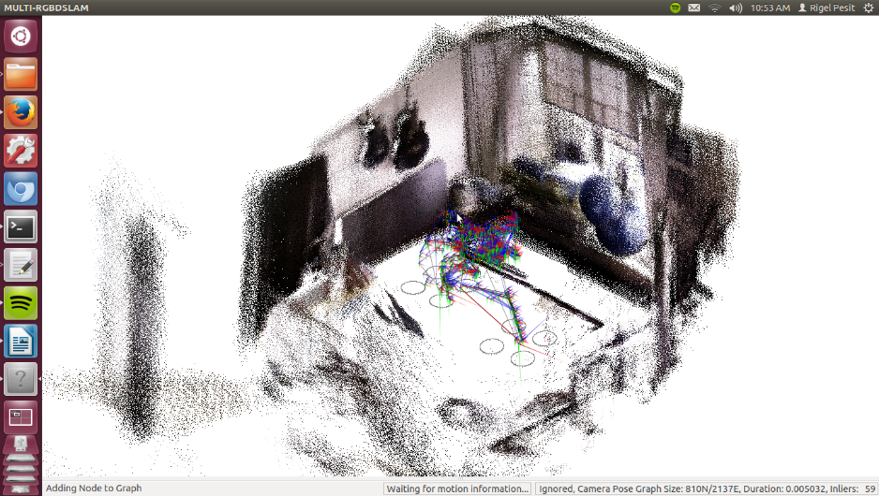
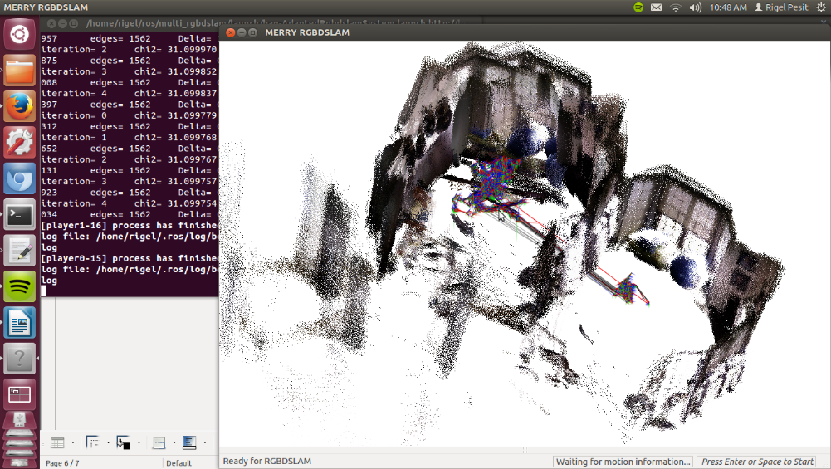
MULTI RGBDSLAM (ORB)

Slide 45
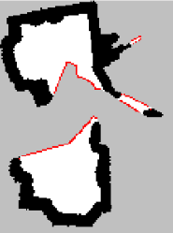
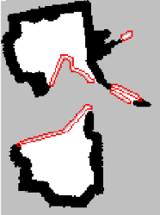
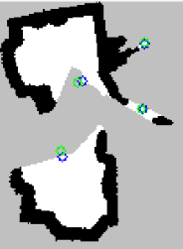
Frontier Detection
Trial 5
Trials | Raw Frontier Count | Dilated Frontier Count
1 | 6 | 4
2 | 4 | 3
3 | 7 | 6
4 | 10 | 4
5 | 11 | 4
Raw Frontiers
Dilated Frontiers
Original (Green) and
Relocated COGs (Blue)
The test was done using a ROS bag file recording at Emmett’s house. The objective was to test the frontier detection of the mission planner. Five sequences were sampled in the ROS bag file recording as shown below. All of the frontiers found are correct. There is no frontier that falls between free and occupied or mislocated.

Slide 46
System Test

Slide 47
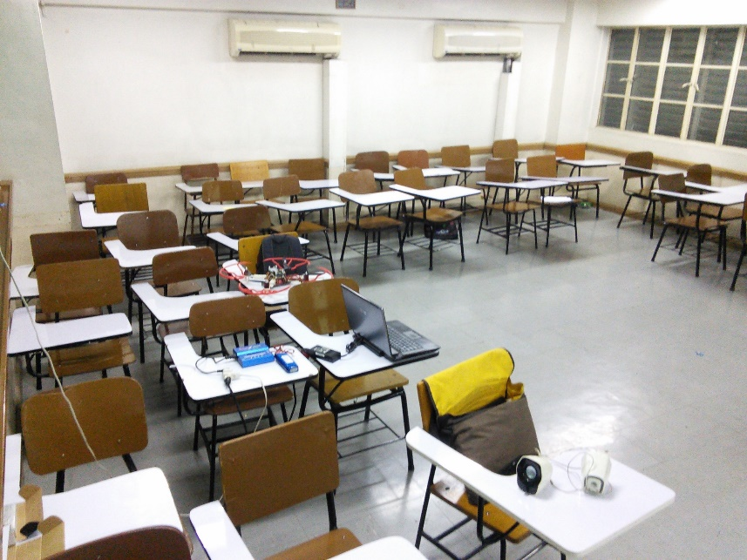
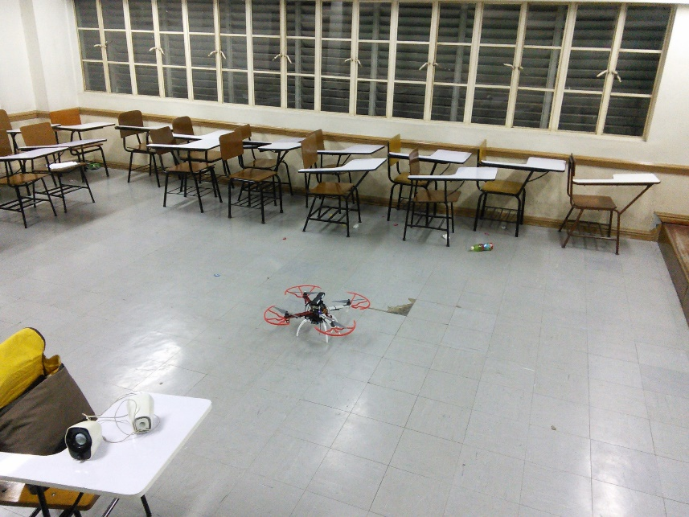
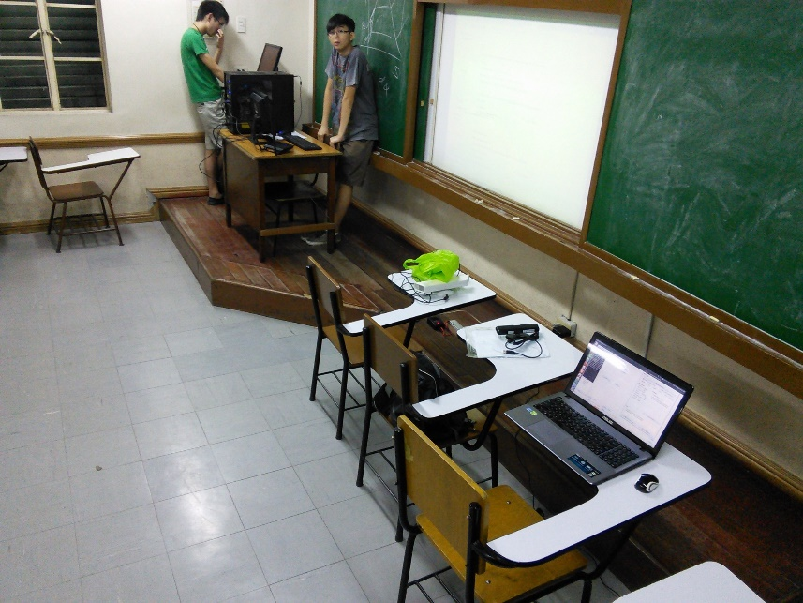
Velasco room v407

Slide 48
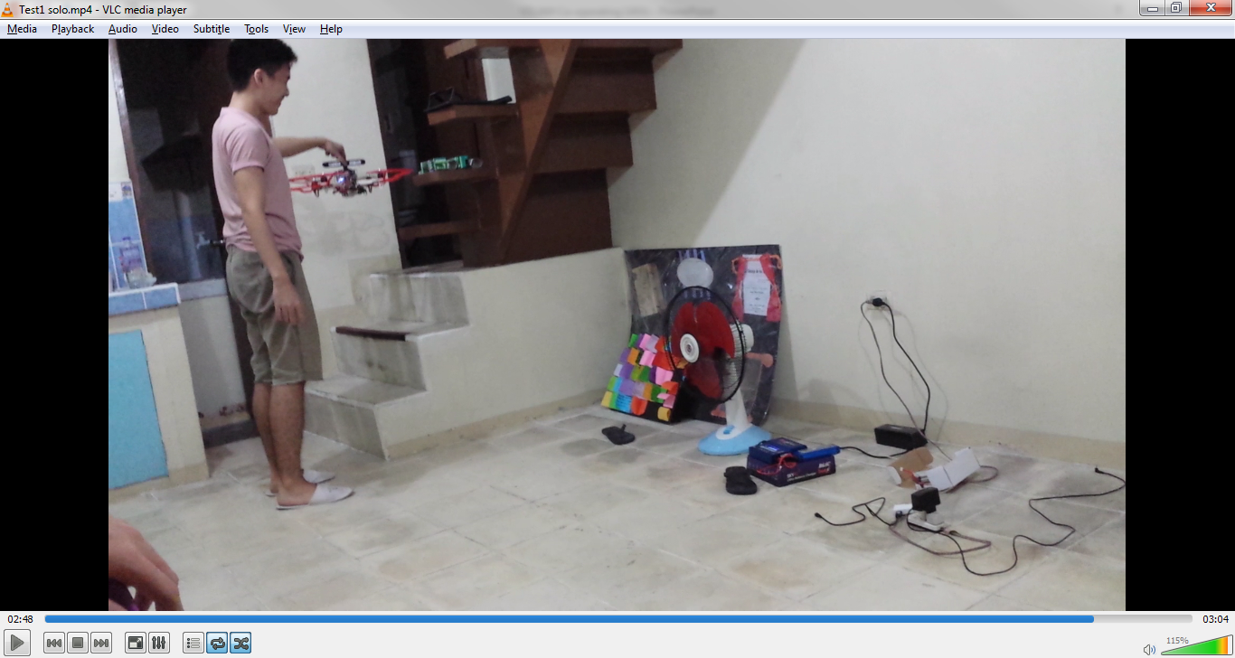
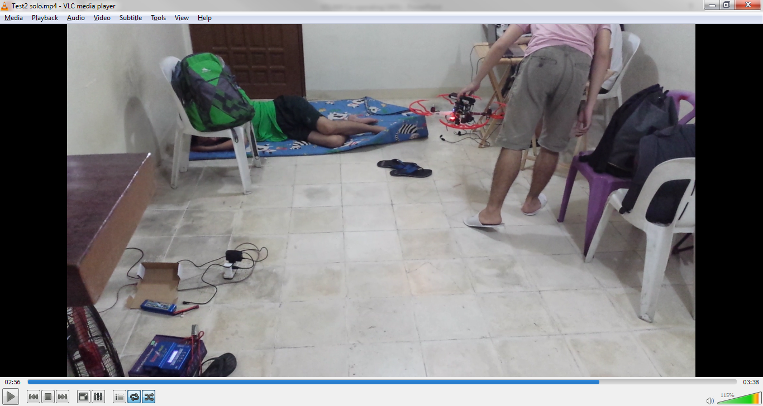
Rap’s apartment

Slide 49
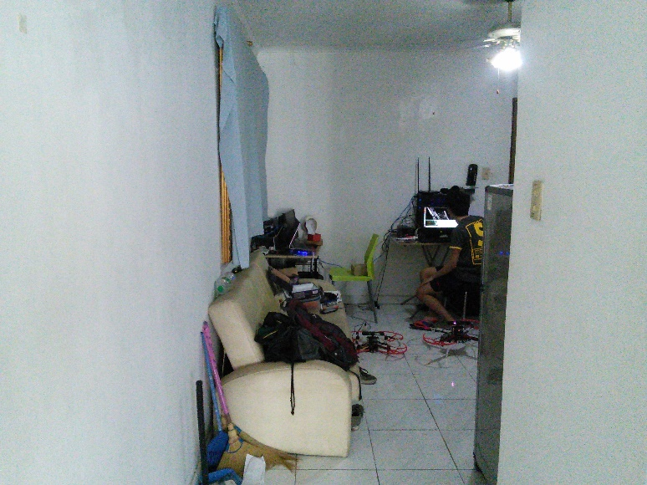
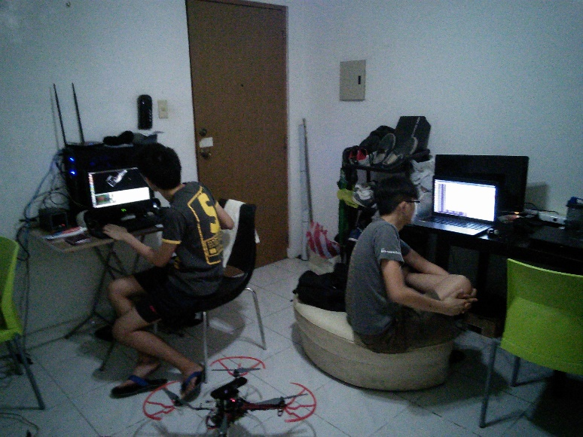
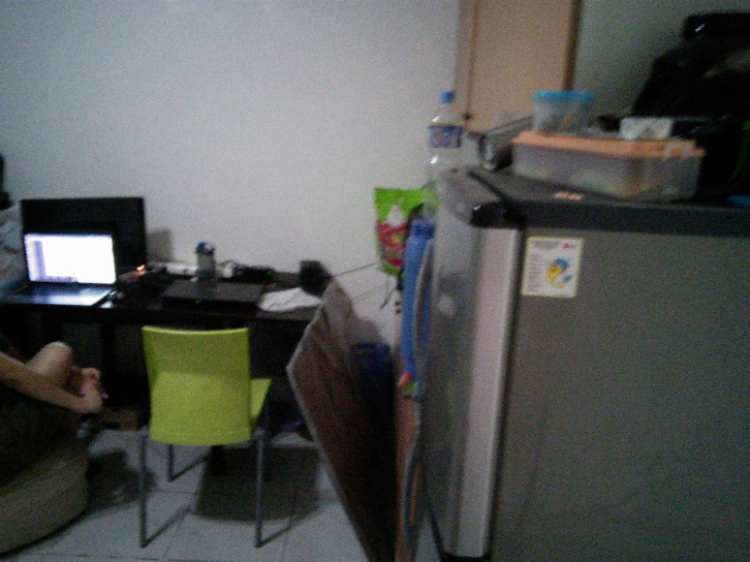
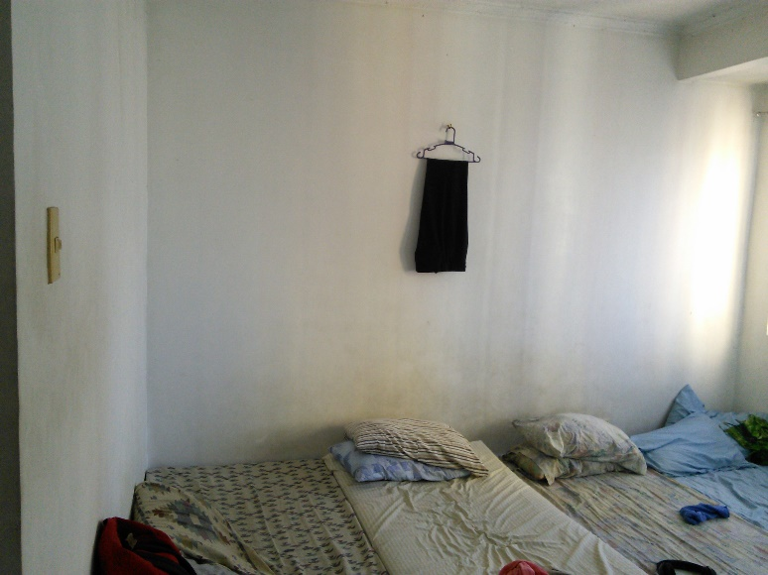
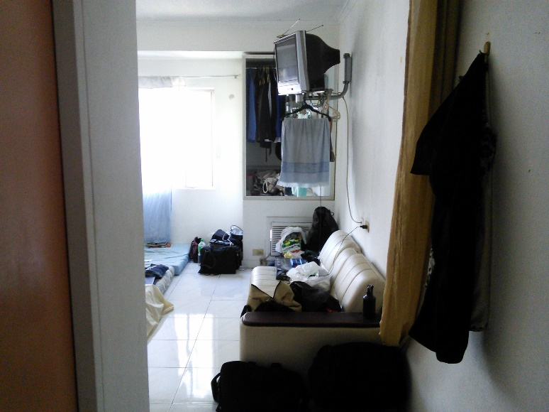
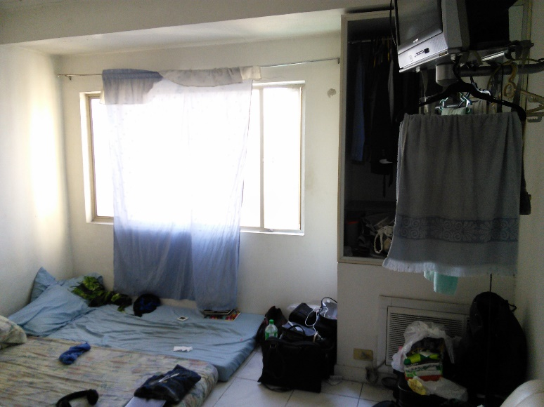
Condo

Slide 50
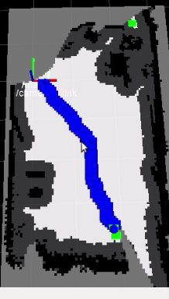
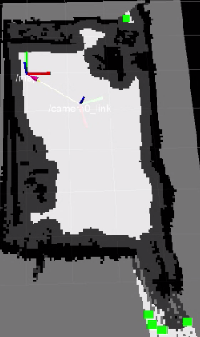
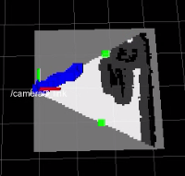
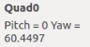
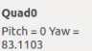
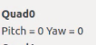
Single Mode Hand Simulated
Rap’s Apartment/25 cm Inflation Radius

Slide 51
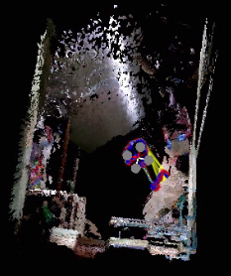
Single Mode Hand Simulated
Rap’s Apartment/25 cm Inflation Radius

Slide 52
Single Mode Hand Simulated
Rap’s Apartment/25 cm Inflation Radius
Trials | Scanning Time | Success of Fail | Remarks on Map | Remarks on Navigation
1 | 2:13 | Fail | Doorway not detected | Localization Failure
2 | 1:54 | Fail | Doorway not detected | Successful
3 | 3:35 | Success | Doorway detected | Successful
4 | 1:32 | Fail | Doorway not detected | Successful
5 | 0:44 | Fail | Doorway not detected | Successful
Since having a 25cm inflation radius prevents the system to detect the doorway as a frontier, the inflation radius was reduced into 20 cm.

Slide 53
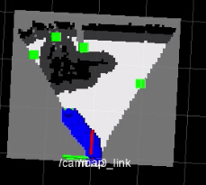
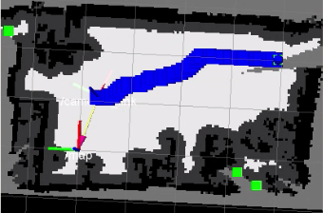
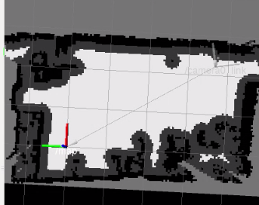
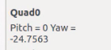
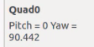
Single Mode Hand Simulated
Rap’s Apartment/20 cm Inflation Radius

Slide 54

Single Mode Hand Simulated
Rap’s Apartment/20 cm Inflation Radius

Slide 55
Single Mode Hand Simulated
Rap’s Apartment/20 cm Inflation Radius
Trials | Scanning Time | Success of Fail | Remarks on Map | Remarks on Navigation
1 | 3:02 | Success | Complete | Successful
2 | 2:53 | Success | Complete | Successful
3 | 2:35 | Success | Complete | Successful
4 | 2:01 | Fail | False Obstacles | Successful
5 | 3:18 | Success | Complete | Successful

Slide 56





Single Mode Hand Simulated
EGI Taft Tower Condo/20 cm Inflation Radius

Slide 57

Single Mode Hand Simulated
EGI Taft Tower Condo/20 cm Inflation Radius

Slide 58
Single Mode Hand Simulated
EGI Taft Tower Condo/20 cm Inflation Radius
Trials | Scanning Time | Overall Success or Fail | Remarks on Map | Remarks on Navigation
1 | 2:06 | Success | Complete | Successful
2 | 2:20 | Success | Nearly Complete | Localization Failure
3 | 3:01 | Fail | False Obstacles | Pose at False Obstacles
4 | 1:01 | Success | Complete | Successful
5 | 2:10 | Fail | False Obstacles | Successful
6 | 1:03 | Success | Complete | Successful
7 | 1:33 | Success | Complete | Successful
8 | 1:28 | Success | Nearly Complete | Localization Failure
9 | 1:30 | Fail | False Obstacles | Successful
10 | 1:20 | Success | Complete | Successful

Slide 59




Single Mode Actual
Velasco – Small Quadrotor

Slide 60

Single Mode Actual
Velasco – Small Quadrotor

Slide 61
SINGLE MODE ACTUAL
Velasco – Small Quadrotor
Trial | Scanning Time | Overall Success or Fail | Remarks on Mapping | Remarks on Navigation
1 | 1:14 | Success | Nearly Complete | Successful
2 | 2:46 | Success | Complete | Successful
3 | 2:14 | Success | Complete | Successful
4 | 1:48 | Success | Nearly Complete | Unpassable Frontier
5 | 1:14 | Success | Nearly Complete | Successful

Slide 62
SINGLE MODE ACTUAL
Velasco – Big Quadrotor
Trial | Scanning Time | Overall Success or Fail | Remarks on Mapping | Remarks on Navigation
1 | 0:45 | Success | Nearly Complete | Successful
2 | 1:21 | Success | Complete | Successful
3 | 1:34 | Fail | False Obstacles | Successful
4 | 1:30 | Success | Complete | Successful
5 | 0:35 | Success | Complete | Successful
6 | 1:00 | Success | Complete | Successful

Slide 63






Single Mode Actual
Rap’s Apartment – Small Quadrotor

Slide 64

Single Mode Actual
Rap’s Apartment – Small Quadrotor

Slide 65
SINGLE MODE ACTUAL
Rap’s Apartment – Small Quadrotor
Trial | Scanning Time | Over all Success or Fail | Remarks on Mapping | Remarks on Navigation
1 | 3:10 | Success | Complete | Unpassable Frontier
2 | 2:28 | Success | Complete | Pose at False Obstacle
3 | 1:48 | Success | Nearly Complete | Localization Failure

Slide 66





Single Mode Actual
Condo – Small Quadrotor

Slide 67

Single Mode Actual
Condo – Small Quadrotor

Slide 68
SINGLE MODE ACTUAL
Condo – Small Quadrotor
Trial | Scanning Time | Over all Success or Fail | Remarks on Mapping | Remarks on Navigation
1 | 3:03 | Success | Complete | Successful
2 | 2:45 | Fail | Incomplete | Unpassable Frontier
3 | 2:00 | Fail | Incomplete | Unpassable Frontier
4 | 2:30 | Success | Complete | Successful
5 | 1:16 | Fail | False Obstacles | Unpassable Frontier

Slide 69






Co-op Hand Simulation
EGI Taft Tower Condo (Navigation)

Slide 70

Co-op Hand Simulation
EGI Taft Tower Condo

Slide 71
Co-op Hand Simulation
EGI Taft Tower Condo (Mapping)
Trial | Over all Success or Fail | Remarks on Mapping
1 | Success | Complete
2 | Success | Complete
3 | Fail | Incomplete
4 | Success | Complete
5 | Fail | Localization Failure

Slide 72





Coop mode ACTuAL

Slide 73

Coop mode ACTuAL

Slide 74
COOP MODE ACTUAL
Velasco
Trial | Scanning Time | Over all Success or Fail | Remarks on Mapping | Remarks on Navigation
1 | 1:47 | Fail | Complete; Duplicate walls | 1 quad pose at false obstacle
2 | 1:40 | Fail | Incomplete; | Poses at false obstacles
3 | 1:16 | Fail | Incomplete | Poses at false obstacles

Slide 75


Broken Camera

Slide 76


Sensor Limitation

Slide 77
Conclusion
Multi Robot SLAM
Sufficient in indoor environments with features and depth data of 3 meters
monoSLAM could be used to increase versatility in larger environments.
monoSLAM makes use of an RGB and an IMU
Notes:
The current MULTI RGBDSLAM system is sufficient in indoor environments with features and depth data of 3 meters. Due to the depth sensor limitation, an alternate SLAM technique, such as monoSLAM, could be used when depth sensor data is invalid. MonoSLAM is a SLAM algorithm that makes use of RGB and an IMU.

Slide 78
Conclusion
Control
Full control of Quadrotor was achieved successfully.
Maintainable height.
Yaws to the goal angle.
Pitches forward towards the goal.
Unexpected drifting due to the flight controller.

Slide 79
Conclusion
Autonomous Exploration
The navigation stack integrated in our system enables our robots to autonomously explore uncharted territories until no frontiers are available.
Currently, the navigation stack commands the robot to navigate to the frontier targets without considering to scan known areas for loop closures which results to completed map with no loop closures.
Improvements in the navigation stack such as considering loop closures promises a more accurate map.
Even though our 2D exploration algorithm is capable of enabling the robots to operate fully autonomously, it limits the robot to create a complete 3D map. It is recommended to implement 3D navigation to overcome such limitations especially since the robots are flying.
Notes:
The navigation stack integrated in our system enables our robots to autonomously explore uncharted territories until no frontiers are available. The reason why there were failures because of the limitation of RGB-D SLAM such as failure to loop close and lack of features. Currently, the navigation stack commands the robot to navigate to the frontier targets without considering to scan known areas for loop closures which results to completed map with no loop closures. Improvements in the navigation stack such as considering loop closures promises a more accurate map. Even though our 2D exploration algorithm is capable of enabling the robots to operate fully autonomously, it limits the robot to create a complete 3D map. It is recommended to implement 3D navigation to overcome such limitations especially since the robots are flying.

Slide 80
Thank you for listening!

